Slide 1
TRAINING MODELS (cont.)
Main reference: Chapter 4 of Géron, A. (2019). Hands-on machine learning with Scikit-Learn, Keras, and TensorFlow.

Slide 2
REGULARIZATION (cont.)

Slide 3
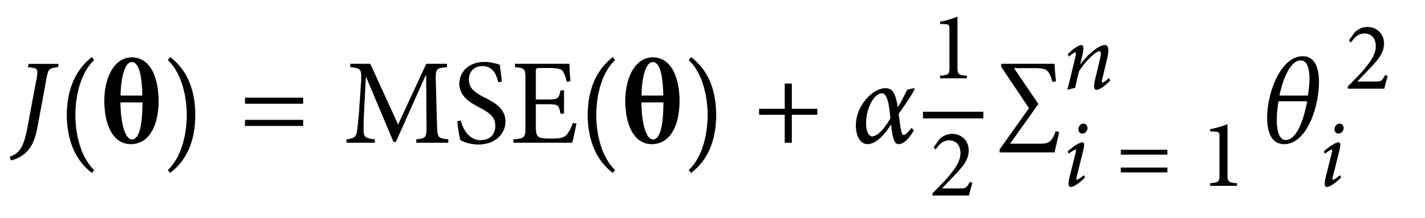
















Ridge regression
Cost function of Ridge regression :

Slide 4
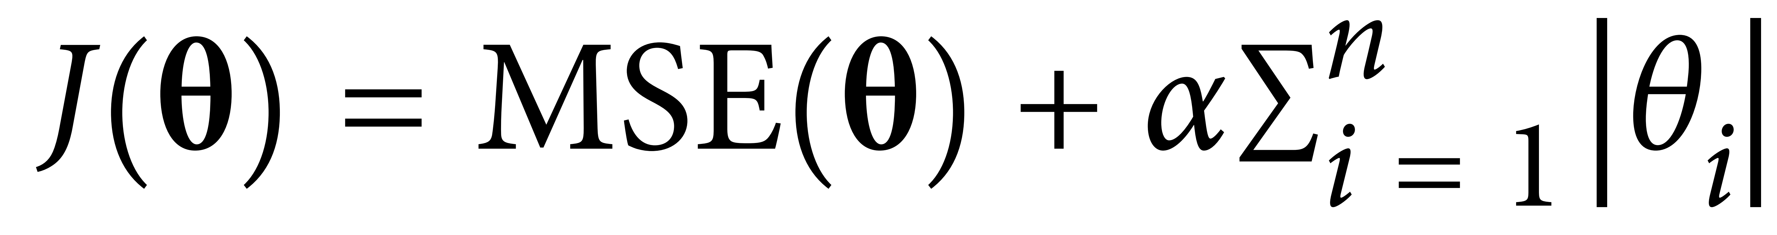



Lasso regression
Cost function of Lasso regression:
➔ Lasso regression is stronger than Ridge regression:

Slide 5


Elastic net
Cost function of Elastic net:

Slide 6
Which one to use?
Listed in order of preference (in practice):
No regulazation (least preferred)
Ridge regulazation
Lasso regulazation
Elastic net (most preferred)

Slide 7
Early stopping

Slide 8



To overcome overfitting
Add more data
Use simpler models
Do regularization
Early stopping (prevents overfitting due to long training)

Slide 9
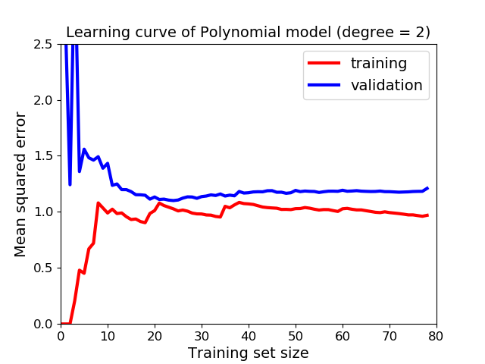




Idea
Stop training as soon as the validation error reaches a minimum.
➔

Slide 10








Implementation
With Stochastic and Mini-batch GD, the curves may be not so smooth.
➔ Stop only after
>> Go to code.

Slide 11
LOGISTIC REGRESSION

Slide 12



What is logistic regression?
Logistic regression is a binary classifier (labels: 0, 1).
It outputs the probability p that a sample belongs to the positive class.
If p≥0.5:
If p<0.5:

Slide 13
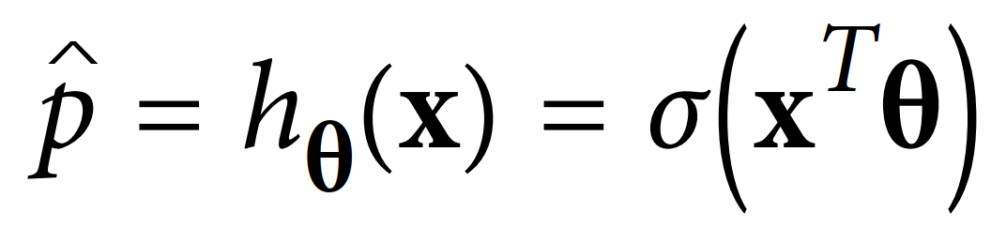
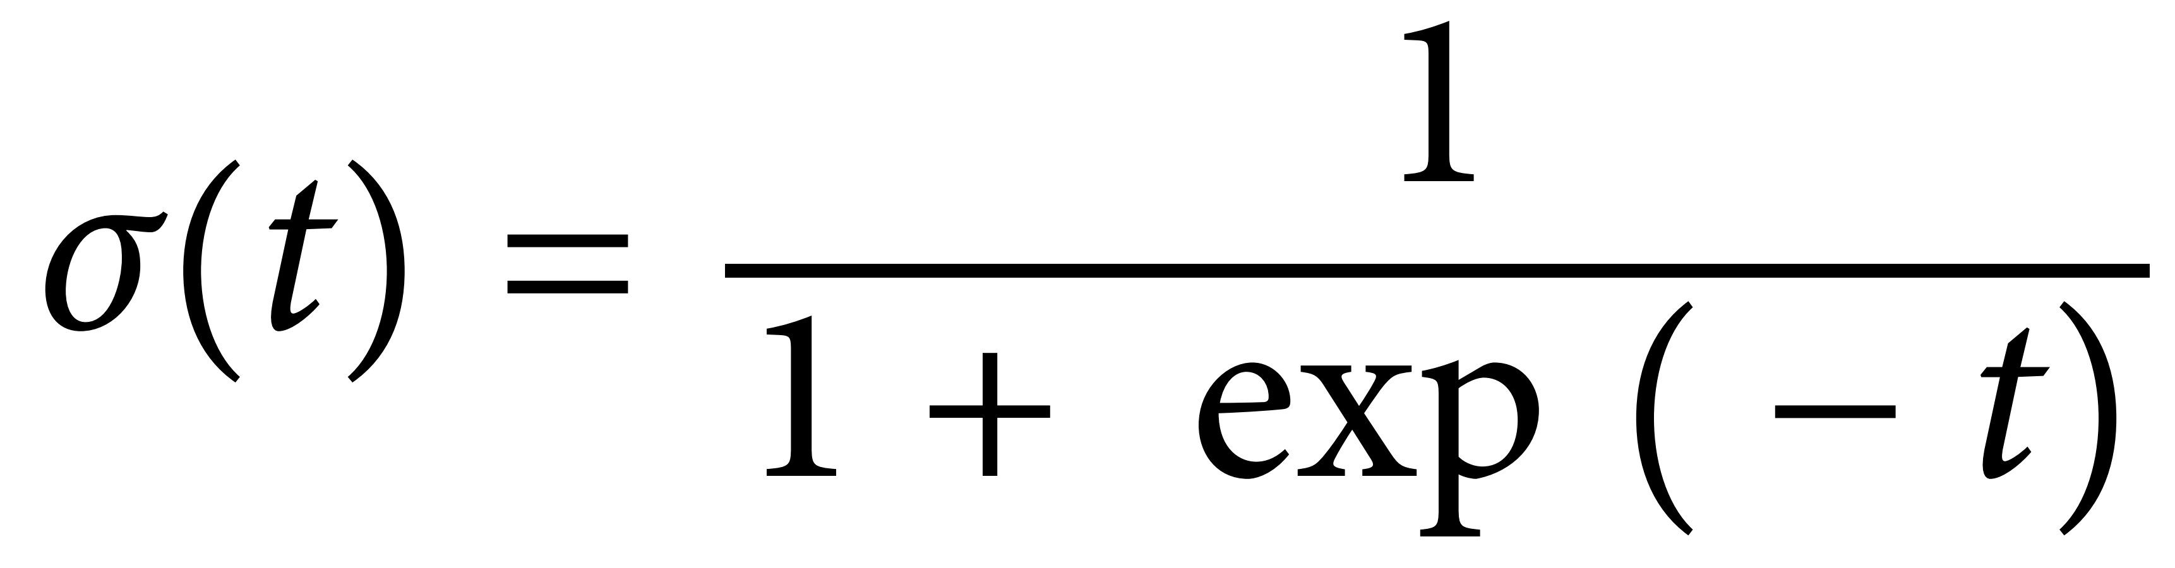

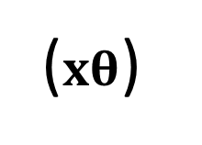



Hypothesis function of logistic regression
The predicted probability:
where σ is the logistic function:
($xθ$)

Slide 14
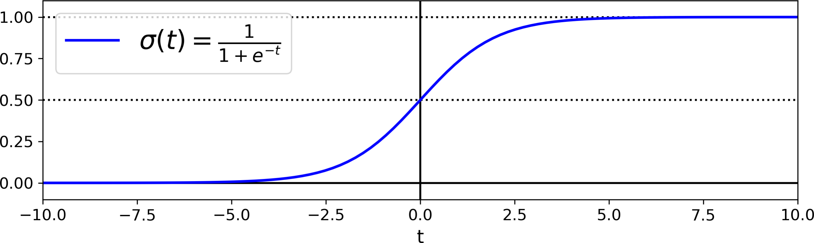


Sigmoid function
Credit: (Géron, 2019)

Slide 15
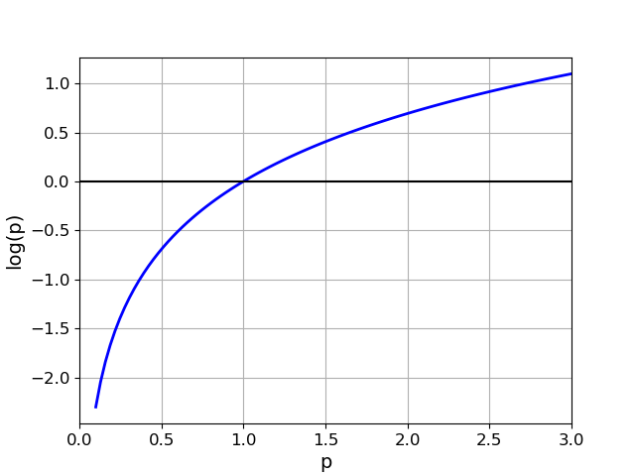
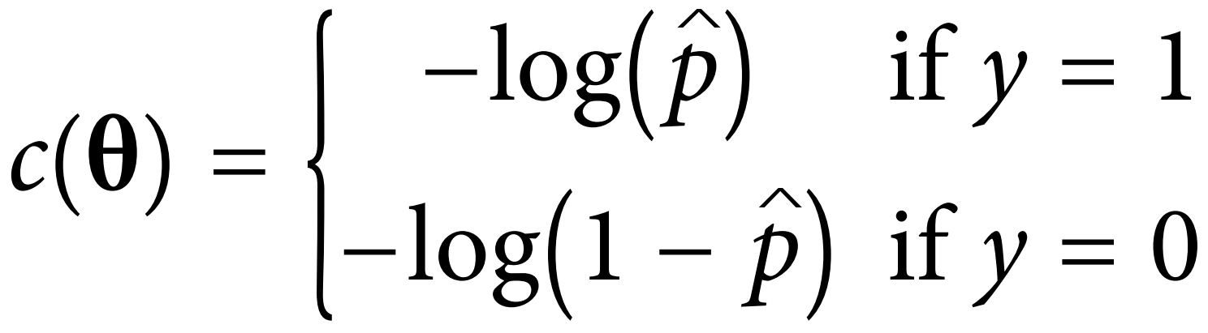
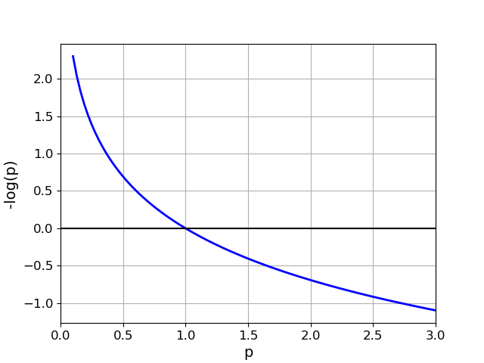


Cost function of logistic regression
Cost function of 1 sample:

Slide 16
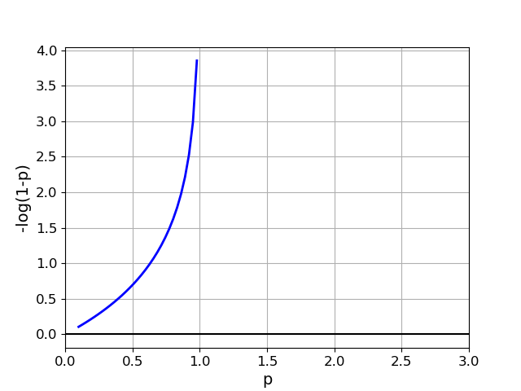






Cost function of logistic regression
Cost function of 1 sample:

Slide 17








Cost function of logistic regression
Cost function of m samples:
Note: the above function is called the Log loss function.

Slide 18
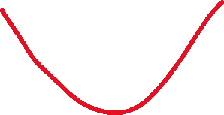
Training with log loss cost function
No closed-form solution.
Log loss is convex:

Slide 19
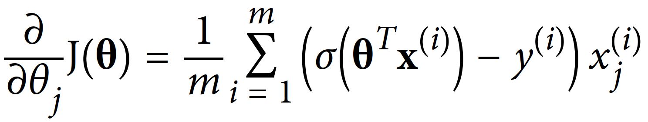
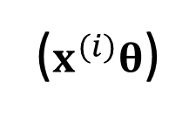

Training using Gradient descent
Gradients of the log loss function:
($x^{(i)}θ$)

Slide 20
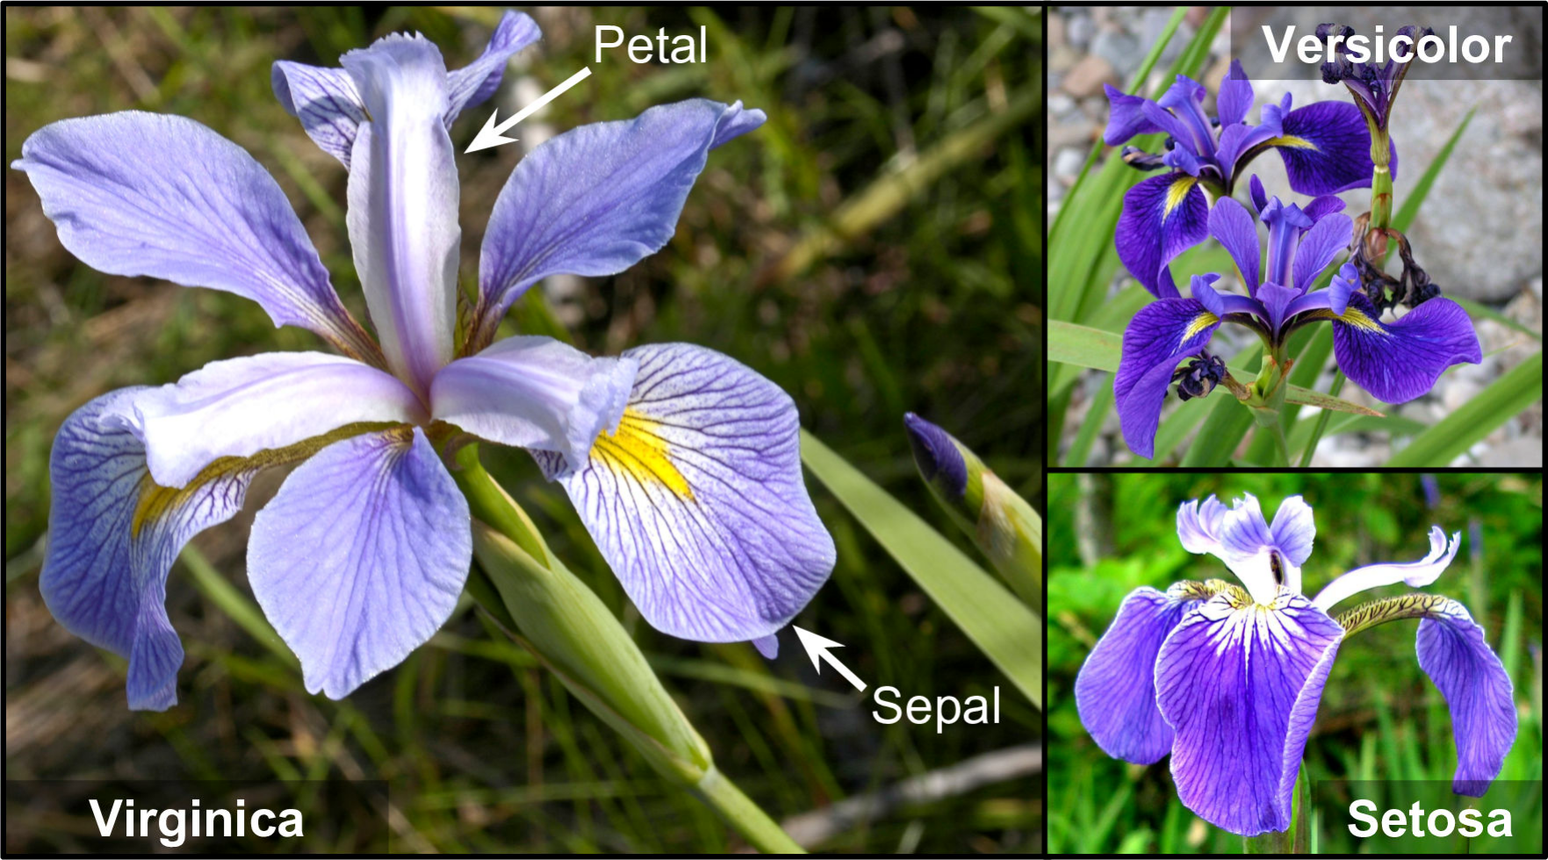






Iris dataset
Features:
Label:
No. of samples:
>> Go to code
Image: (Géron, 2019)

Slide 21



Decision boundaries

Slide 22




Decision boundaries
Split space into 2 parts:

Slide 23








Decision boundaries
For 1-feature data, linear model:
For 2-feature data, linear model:

Slide 24
Softmax Regression

Slide 25

Softmax regression
Softmax regression (a.k.a. Multinomial Logistic Regression) is a multi-label classifier (labels: binary vectors).

Slide 26


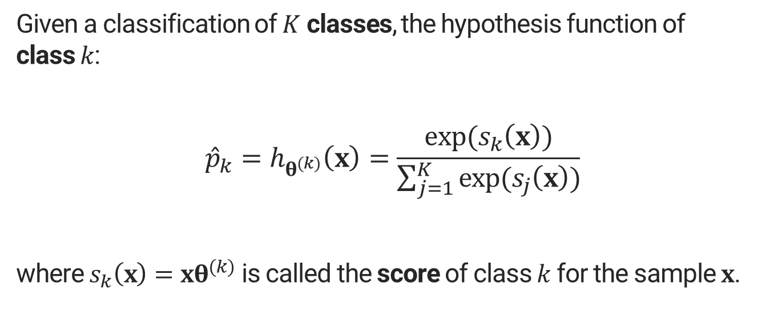
Hypothesis function of softmax regression
Given a classification of $K$ classes, the hypothesis function of class $k$:
$${\hat{p}}_{k}=h_{θ^{(k)}}\left(x\right)=\frac{exp⁡(s_{k}\left(x\right))}{\sum_{j=1}^{K}{exp⁡(s_{j}\left(x\right))}}$$
where $s_{k}\left(x\right)=xθ^{(k)}$ is called the score of class $k$ for the sample $x$.

Slide 27

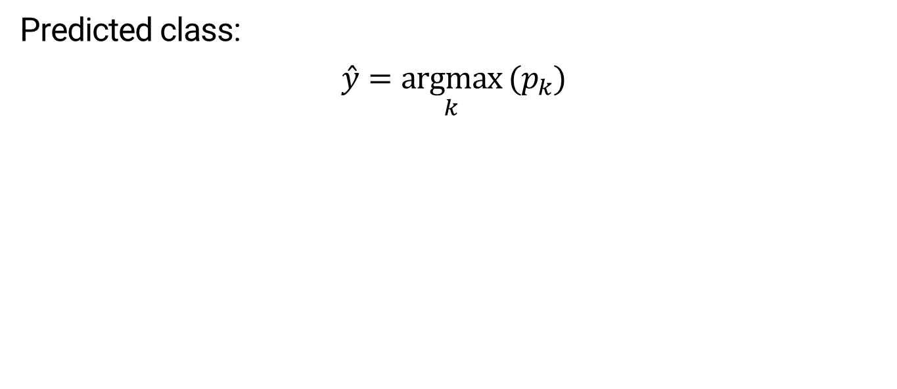
Prediction
Predicted class:
$$\hat{y}=\underset{k}{argmax} (p_{k})$$

Slide 28
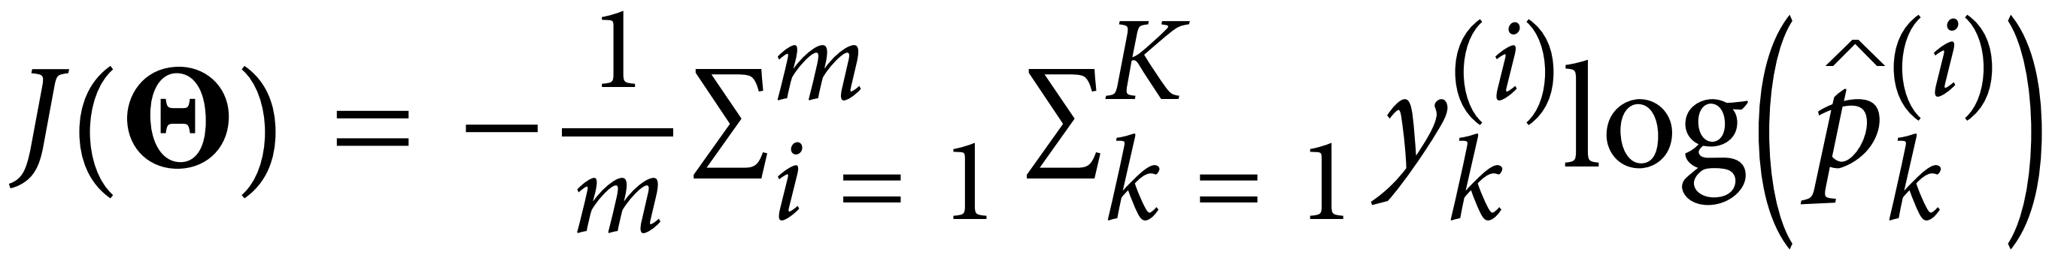

Cost function of softmax regression
Note: the above function is called the Cross entropy function.

Slide 29





Cost function of softmax regression

Slide 30
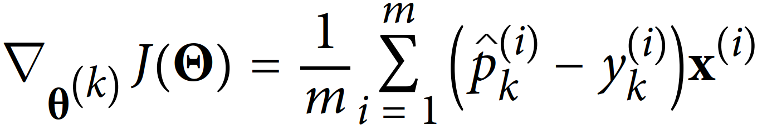
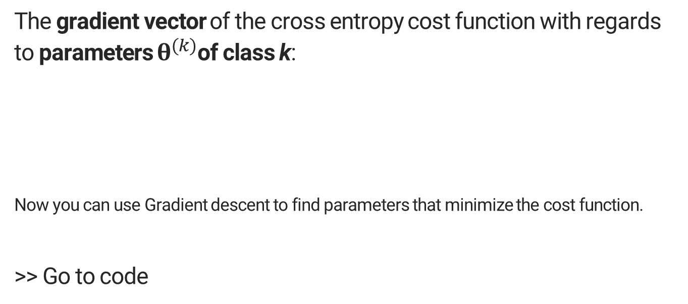
Gradients of the cross entropy cost function
The gradient vector of the cross entropy cost function with regards to parameters $θ^{(k)}$of class k:
Now you can use Gradient descent to find parameters that minimize the cost function.
>> Go to code

